Slide 1
The Art of the ReprEx
(Reproducible Example)
Rosemary Hartman, DWR
5/21/2020

Slide 2

Help!
My code doesn’t work. Can anyone tell me why?
Notes:
What code are you using? What packages are involved? What are you trying to do with it? I honestly don’t even have time to try.

Slide 3

Help!
I am trying to use the function “pivot_longer” from package “tidyr” to switch my data from “wide” format to “long” format, and it won’t work. Has anyone used this package before?
Notes:
Better. You have told the reader exactly which function you are having trouble with and what you are trying to do. But this still doesn’t tell us enough to help you.

Slide 4

Help!
I am trying to use the function “pivot_longer” from package “tidyr” to switch my data from “wide” format to “long” format, but it won’t work.
I tried this code:
foo = pivot_longer(iris, names_to = "measurement", values_to = "value")
it gave me the following error message:
Error: `cols` must select at least one column.
Notes:
Better. Now we know exactly what you tried and your exact error message. In this case, I can see your mistake without running the code. You are missing the “cols” part of the function call.

Slide 5

Help!
I am trying to use the function “pivot_longer” from package “tidyr” to switch my data from “wide” format to “long” format, but it won’t work.
I tried this code:
foo = pivot_longer(iris, cols = c(Petal.Width, Petal.Length, Sepal.width, Petal.width), names_to = "measurement", values_to = "value")
it gave me the following error message:
Error: Can't subset columns that don't exist. x The column `Sepal.width` doesn't exist
Notes:
But it might be a little harder to figure out your problem. I really can’t help you without seeing our data and trying the code myself.
Notice, I barely have enough room for the cat meme here.

Slide 6

We need a reproduceable example! (ReprEx)
Notes:
Sorry, I couldn’t find a cat for this one.

Slide 7
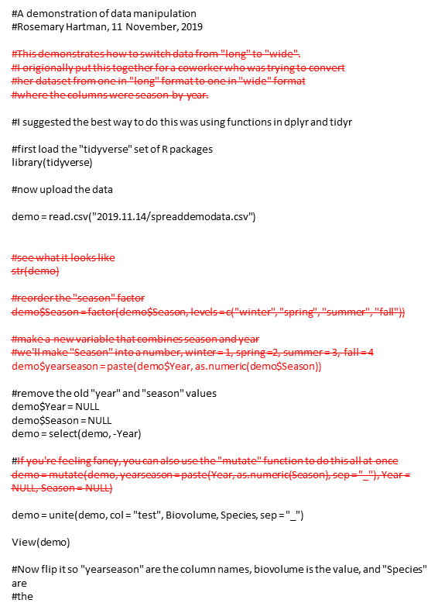
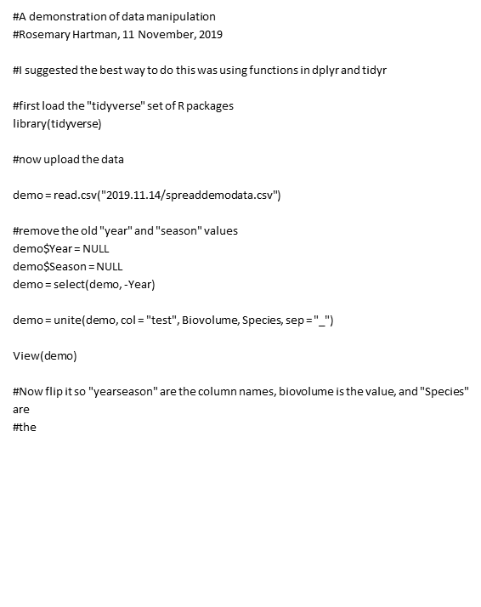

Step One: Subset your code
Put the code you are having trouble with into a clean script or markdown file.
Notes:
This will probably mean subsetting just a small part of the larger project you are working on. Don’t make a helper slog through 500 lines of code if you are only having trouble with a small section!

Slide 8

Some things to watch out for
Make sure you don’t have any references to files on your computer.
read.csv(workingdirectory/data/file)
NOT read.csv(C://Mycomputer/users/Rosie/workingdirectory/data/file)
Load all required packages at the beginning
Use style conventions when possible: http://stat405.had.co.nz/r-style.html

Slide 9

Step 2: Comment!!
Make sure your code is well commented so that someone else knows exactly what you are trying to do and where you are having trouble.

Slide 10
Step three: Prepare some data that will be used in the example (real or fake)
Just share all the data!
BUT! Pare it back so it’s just the data you are using.
Subset a small amount of your data that is useless by itself for anything other than a demo
Use “sample_n” from dplyr
Make some dummy data
rnorm
Try and get the problem to repeat itself with one of R’s built-in data sets
cars, mtcars, iris, ToothGrowth, USAarrests http://www.sthda.com/english/wiki/r-built-in-data-sets#list-of-pre-loaded-data

Slide 11

Step 4: Test it out.
Make sure it runs when your environment has been cleared.
Double-check that you have loaded any required packages.
If possible, check it on a different computer

Slide 12

Yes! This will take some time .
But it will take a lot less time than banging your head against a wall!
It also respects other people’s time. I’m not likely to help you if it takes forever to understand what you want.

